Slide 1
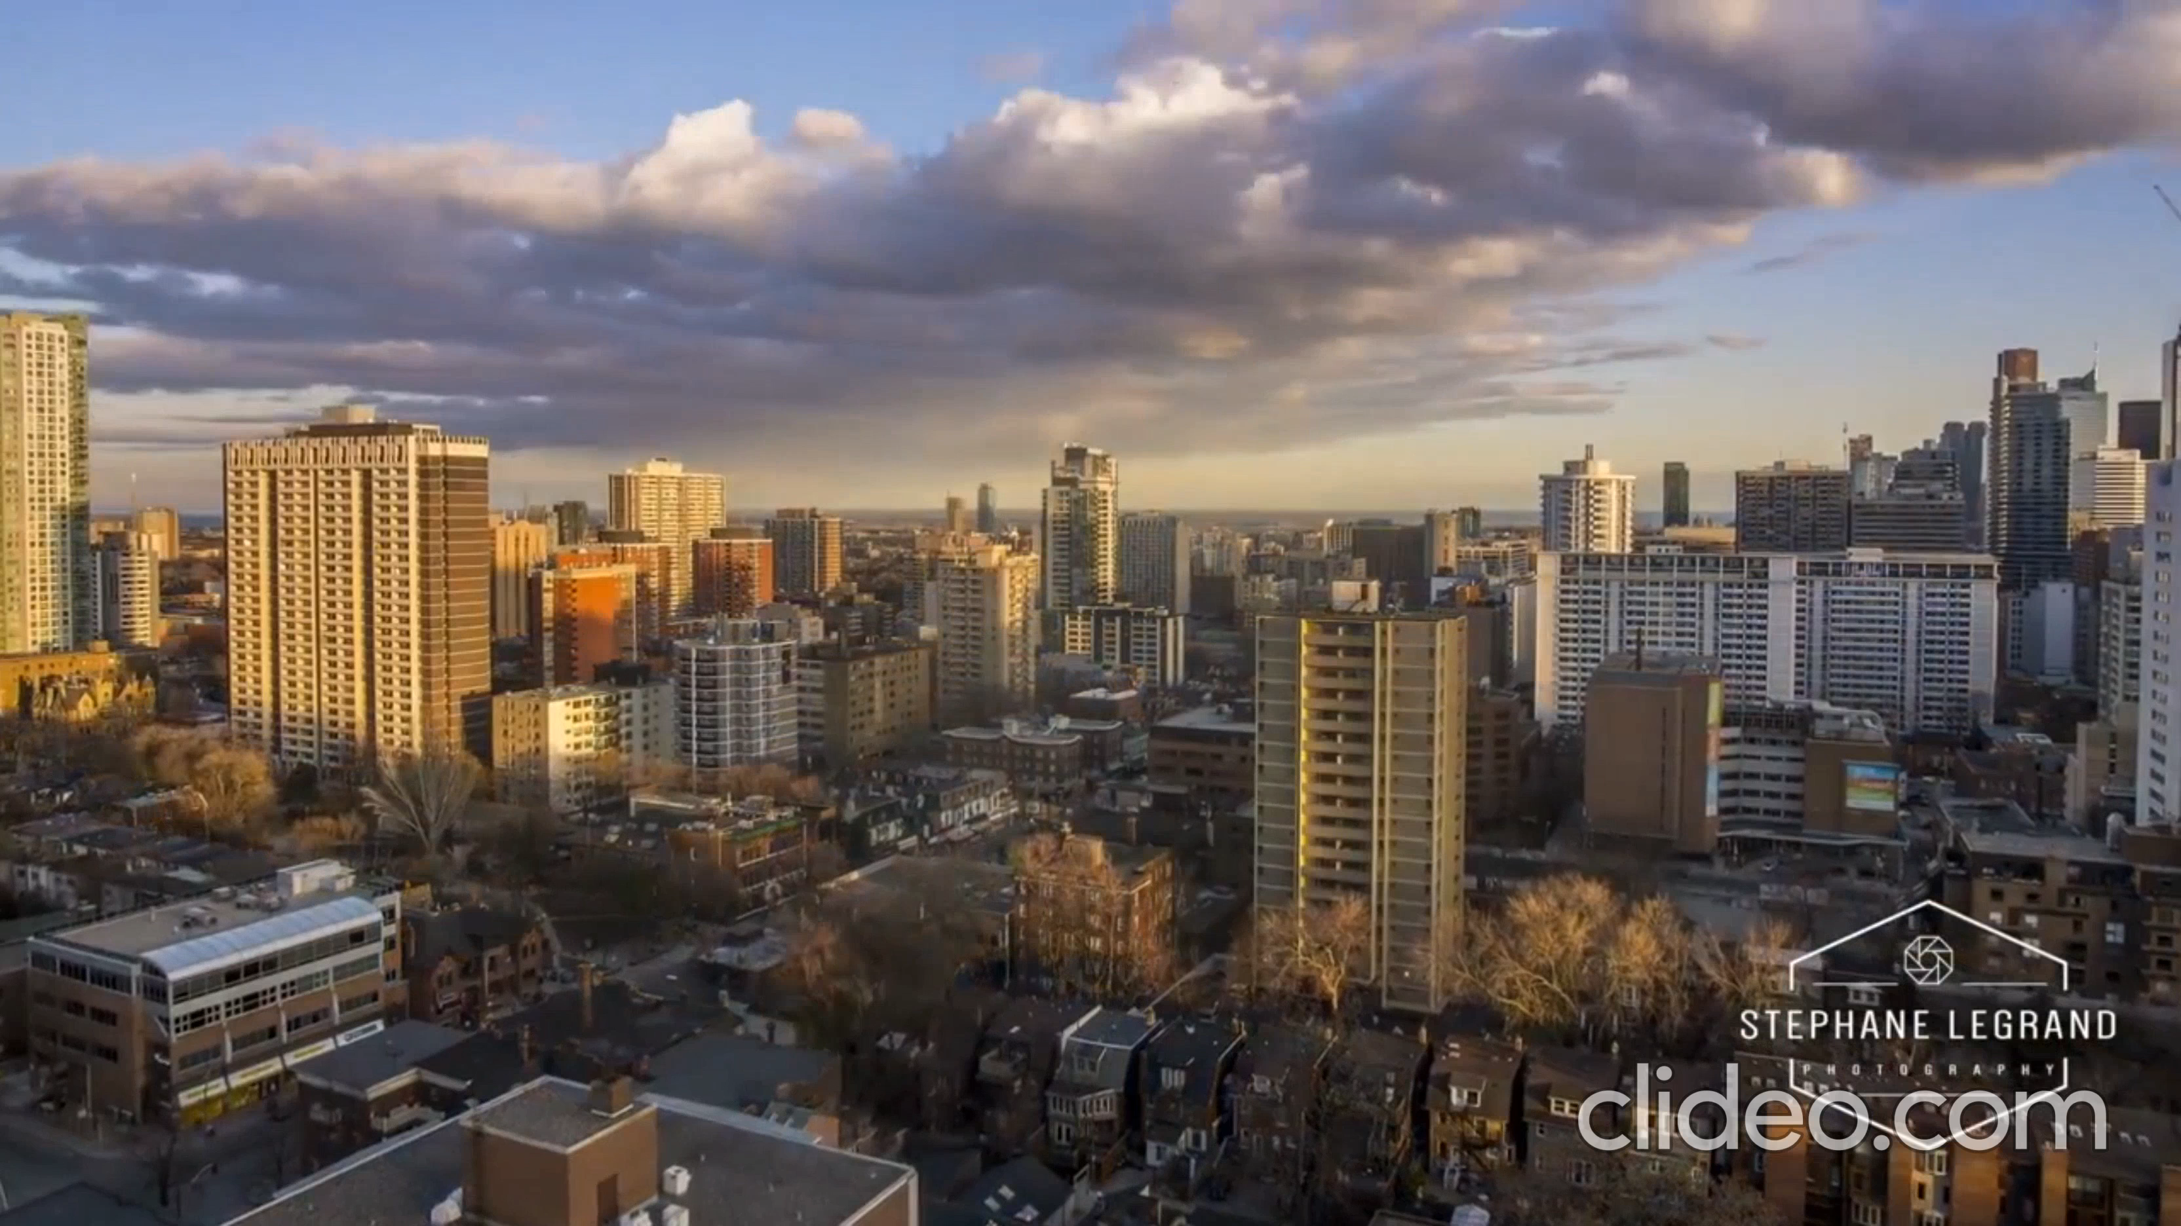

Slide 2
A VISUALIZATION OF CONDO BUILDING PERMITS AND RENTAL PRICES IN THE CITY OF TORONTO FROM 2010 TO 2018
An interactive dashboard showing a geographical map of neighbourhoods in the City of Toronto
and Infographic bar charts presenting historical rental prices.

Slide 3
Presented by TEAM ‘GLOK’
G - Gloria Abromeit
L - Janet Garcia
O- Omer Kleiner
K - Kanwal Bhatia

Slide 4
















Built with…

Slide 5
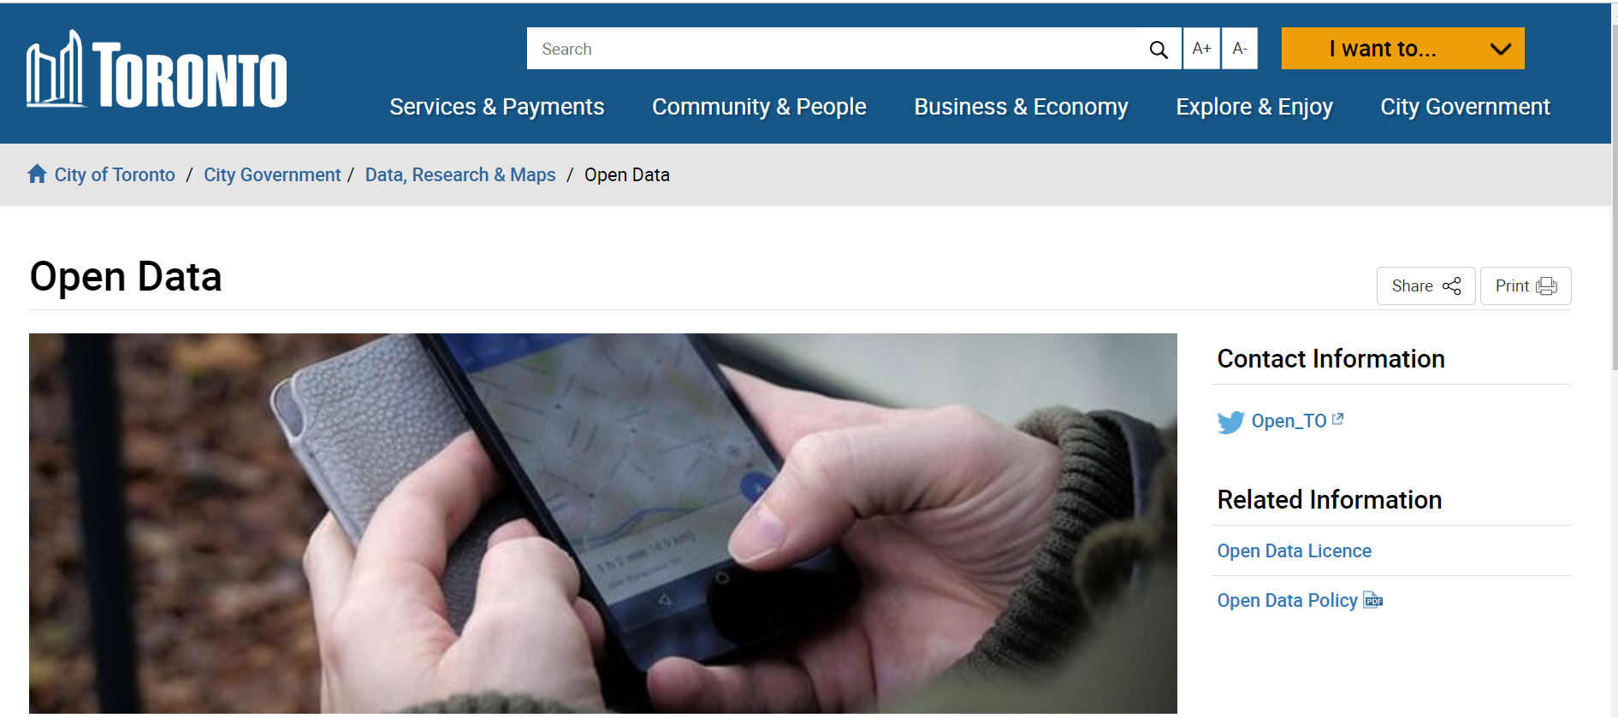

Driven by data from…
- The City of Toronto’s Open Data
https://open.toronto.ca/dataset/building-permits-cleared-permits-prior-years/
- Canada Mortgage and Housing Corporation (CMHC)
https://www03.cmhc-schl.gc.ca/hmip-pimh/en/TableMapChart/Table?TableId=2.2.11&GeographyId=2270&GeographyTypeId=3&DisplayAs=Table&GeograghyName=Toronto

Slide 6




From ‘raw’ to ‘awe’
.
Raw
Web browser
Awe

